Slide 1
Eyes of the world
Notes:
Good morning/afternoon everyone. Welcome to our assembly.

Slide 2
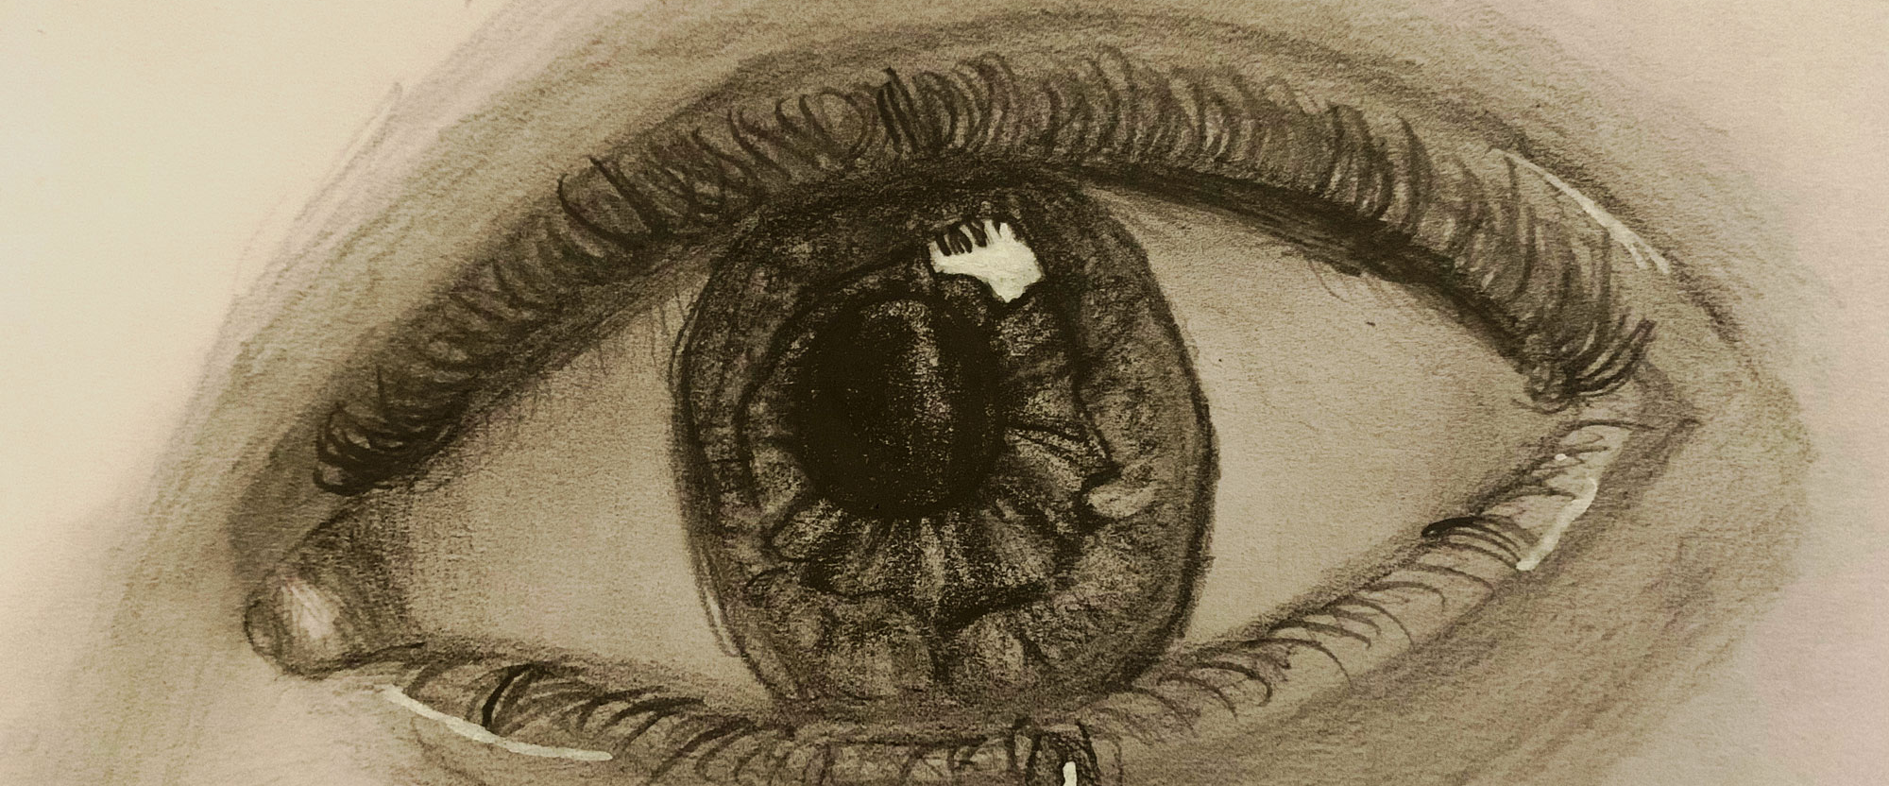
Notes:
Did anyone ever say to you, “I’ve got my eye on you”?
If so, how did it make you feel? Uncomfortable? Or perhaps you felt determined to do better?
This year, CAFOD is asking us to tell world leaders that our eyes are focused on them.
We want them to be determined to look after the planet and all the people who live on it, especially the poorest.

Slide 3
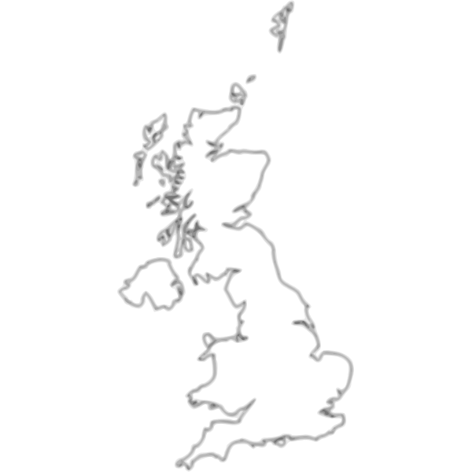
Glasgow
COP26
1 – 12 November
Notes:
In November, world leaders will meet in Glasgow to discuss the climate, how it is changing and what should be done about it.
This meeting is called COP26. And it is a big deal!
It has never been more urgent that humanity resolves together to protect the Earth and all of its inhabitants.

Slide 4
Eyes of the world film
Film
Notes:
Let’s find out more by watching this film.
[Watch our Eyes of the World campaign film, downloadable from cafod.org.uk/secondary]

Slide 5
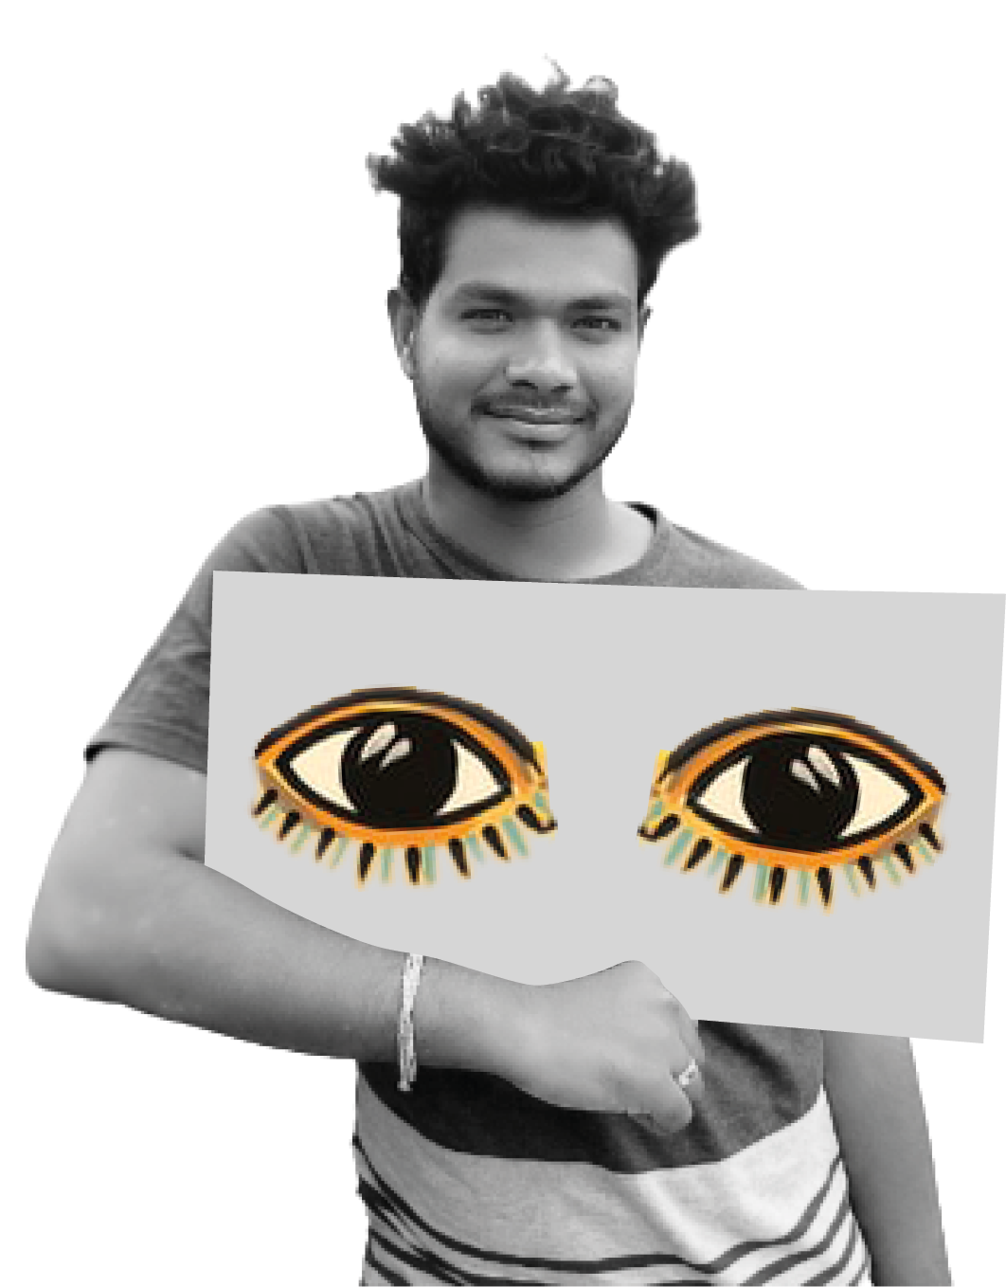
Notes:
As we heard in the film, we are speaking up for people around the world who are suffering severely because of the climate crisis.

Slide 6
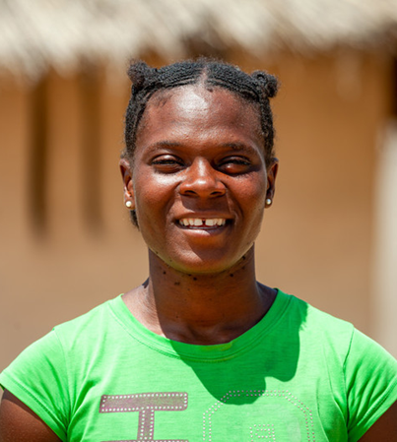
Florence
Zimbabwe
Notes:
People like Florence.
Florence lives in Zimbabwe. She walks to a well or a borehole to fetch the water that she needs.
But because of changes in the climate, the rains have become unpredictable and the wells have dried up.

Slide 7
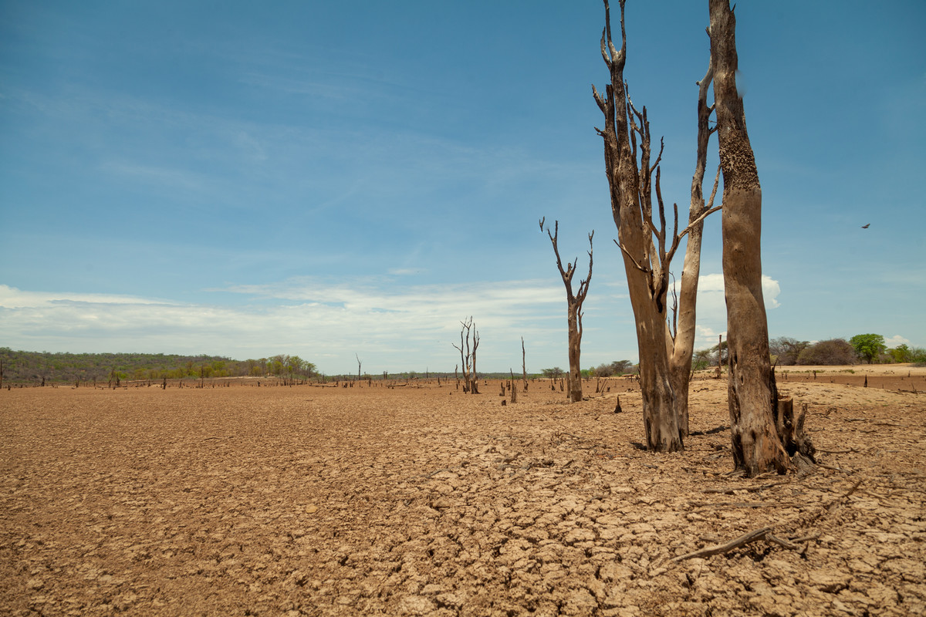
Notes:
Florence now has to walk four miles to find water, and the water source is also where crocodiles live.
She and her family struggle to get enough water to drink and to grow food.
CAFOD has helped people like Florence by providing emergency food and safe, clean water.
However, because of changes in the climate, these problems could continue to happen.

Slide 8
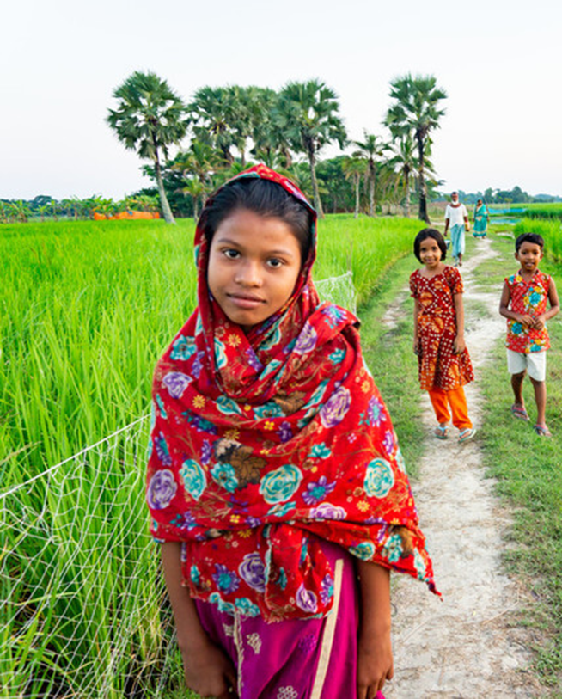
Fatima
Bangladesh
Notes:
This is Fatima. She lives in Bangladesh.
The land in her area is under threat from heavier storms and rising sea levels, caused by climate change.
CAFOD is working with Fatima’s community, helping them to find new ways to grow food in this changing climate.

Slide 9
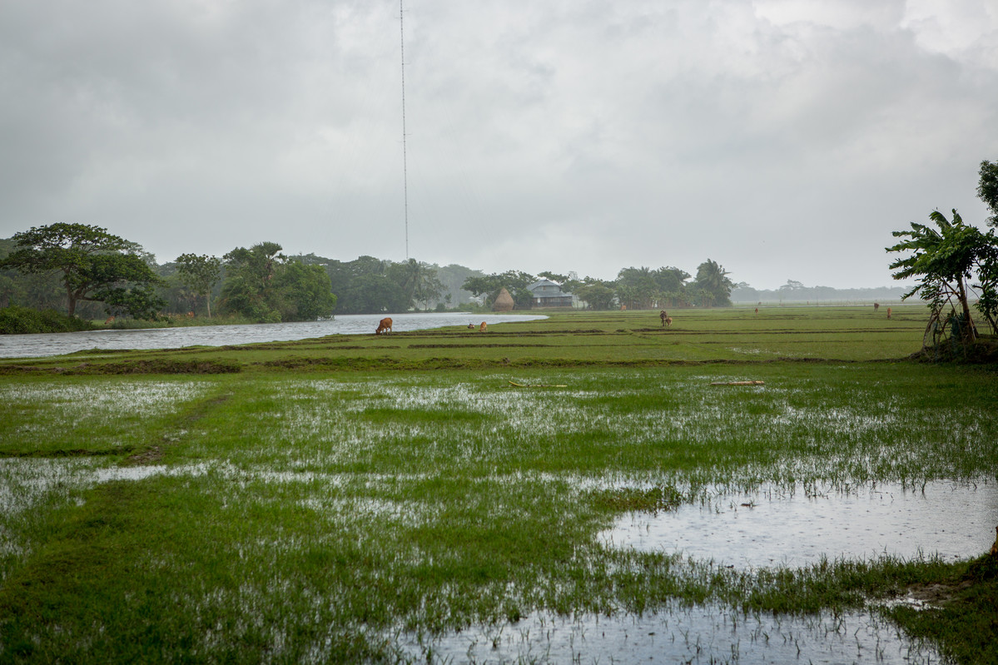
Notes:
Women like Fatima’s mum, Rubina, are learning about seeds that grow even when there is heavy rain.
They are trying out new crops, and are starting to sell compost to earn money.
This project in Bangladesh is all about making sure that people are able to grow food, make a living and also take care of the environment.

Slide 10
Caring for
people and the planet
Notes:
So, what can we do, so that fewer communities like Florence’s and Fatima’s have to suffer the effects of climate change?
Well, we can make changes in our own lives and in our daily choices. Our choices affect the planet and its people.
We can think about the things we buy, the food we eat, and the ways we travel.
The global population needs to buy, consume and waste less, and to recycle and upcycle more.
That includes you and me.

Slide 11
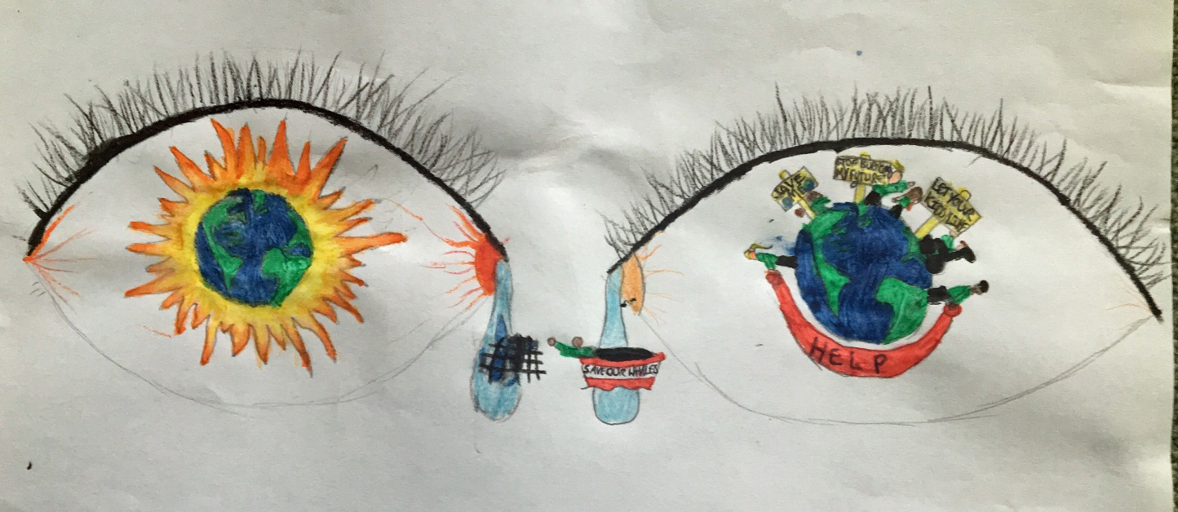
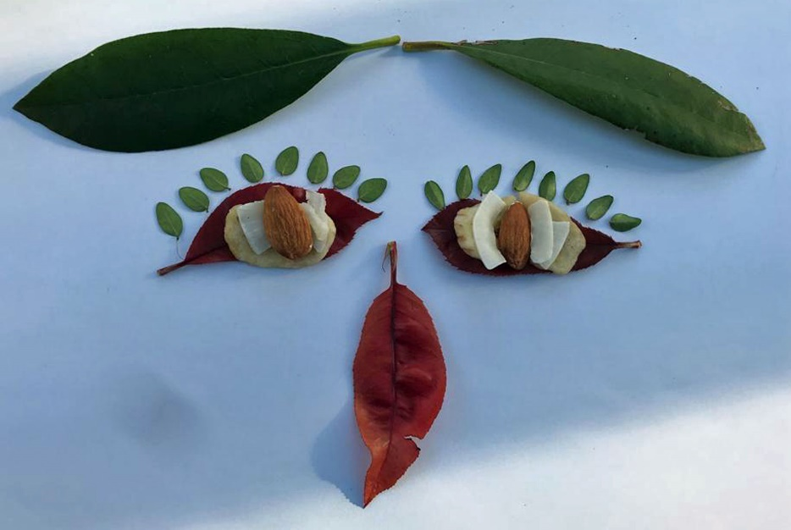
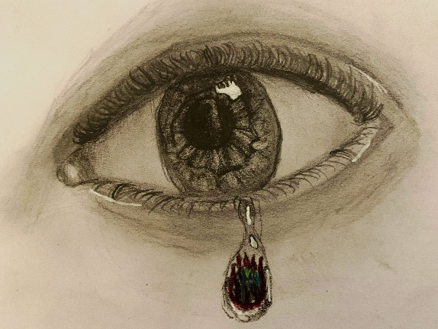
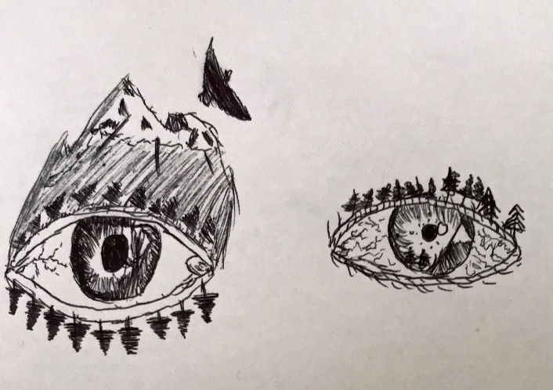
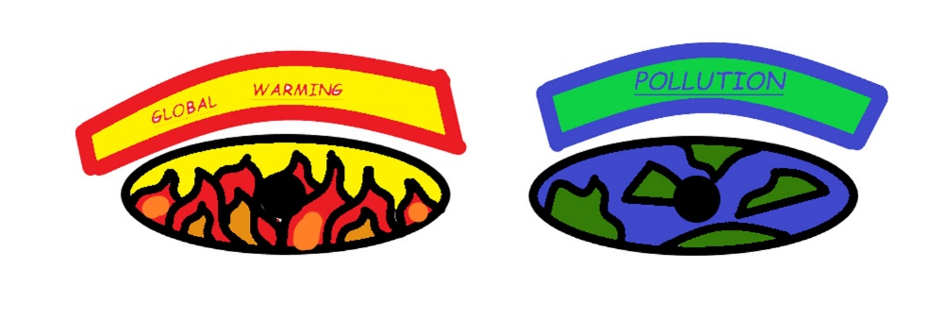
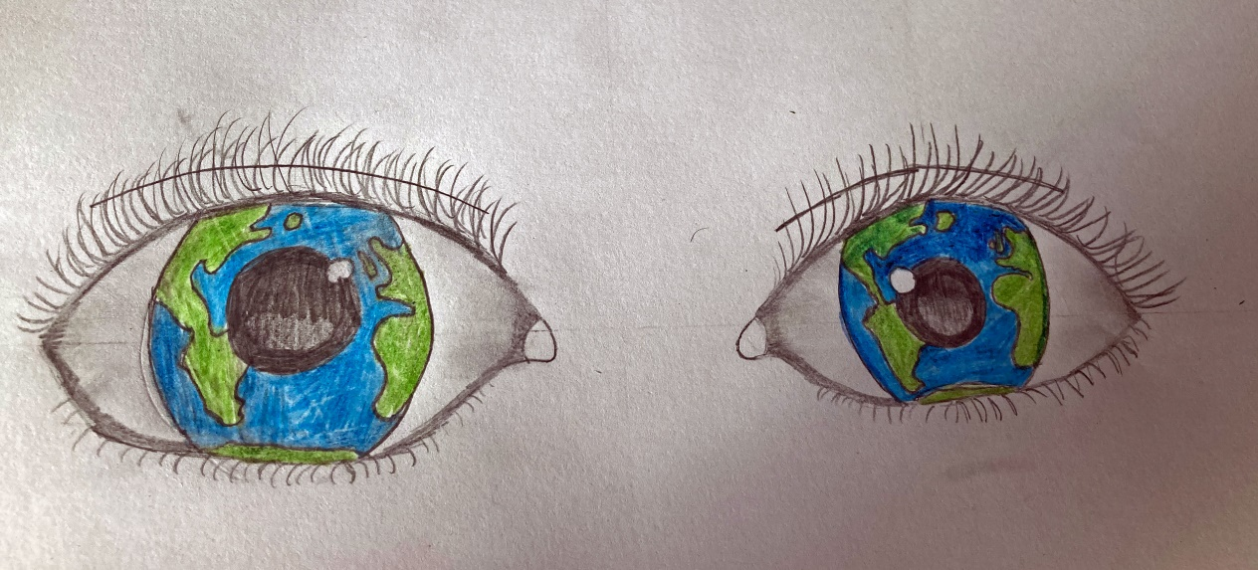
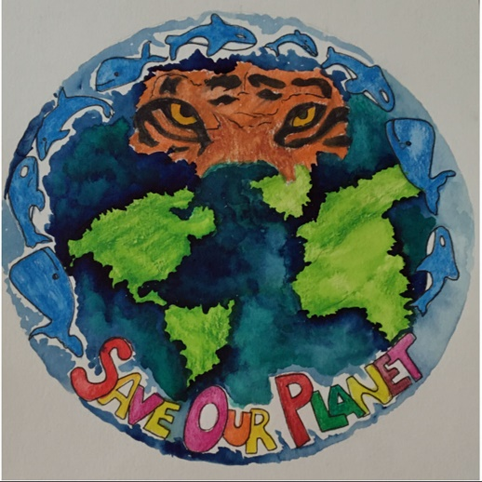
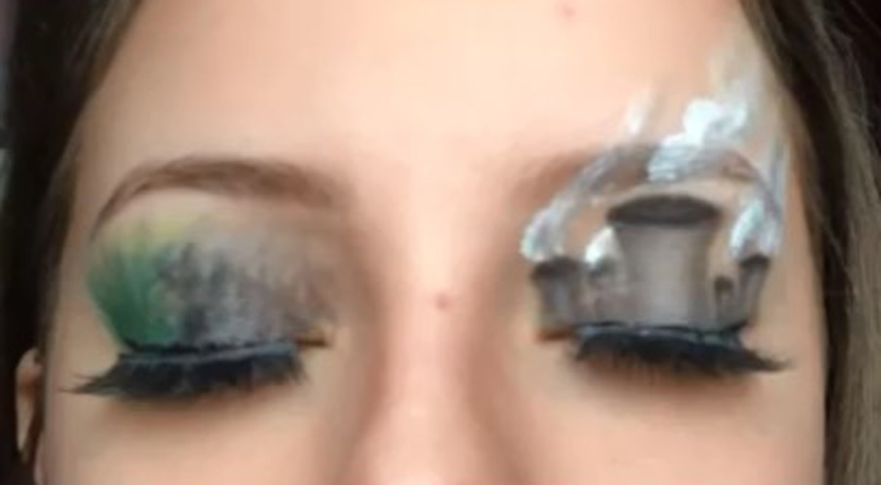
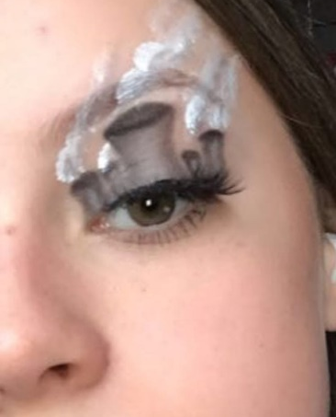
Notes:
As well as making changes in our own lives, together we can influence world-changing decisions.
Young people all over England and Wales are letting the Government know that we will be watching them …to make sure they think about the world’s poorest people as they make their decisions at the COP26 climate meeting this November.

Slide 12
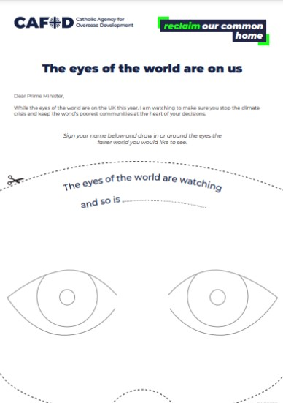
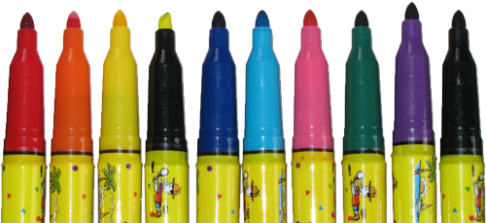
Notes:
We can join with the rest of the country, making thousands of images of eyes, to show our leaders that the eyes of the world are watching, and so are we!
CAFOD has a template on their website, or we can design our own eye images.
[ INSERT HERE DETAILS OF HOW YOU WILL DO THIS IN YOUR OWN SCHOOL. FOR EXAMPLE, “AT LUNCHTIME IN THE HALL TODAY, ….” ]
Another way we can all come together and make a difference is by praying for a world where no-one suffers because of climate change.
So, let’s pray now for every corner of the Earth….

Slide 13
We look to the south and think of those facing drought and hunger.
We pray together:
Creator God, we pray for our brothers and sisters who are hungry and thirsty. Help us to share what we have generously. Amen.
Notes:
In the name of the Father, and of the Son, and of the Holy Spirit, Amen.
[Teachers – for smaller groups of students, you could invite everyone to stand and face each of the four directions in the prayer]

Slide 14
We look to the east and think of those facing floods.
Let us pray together:
Living God, we pray for communities under threat of flooding. Bring comfort to people in need. Amen.
Notes:
Let us pray.

Slide 15
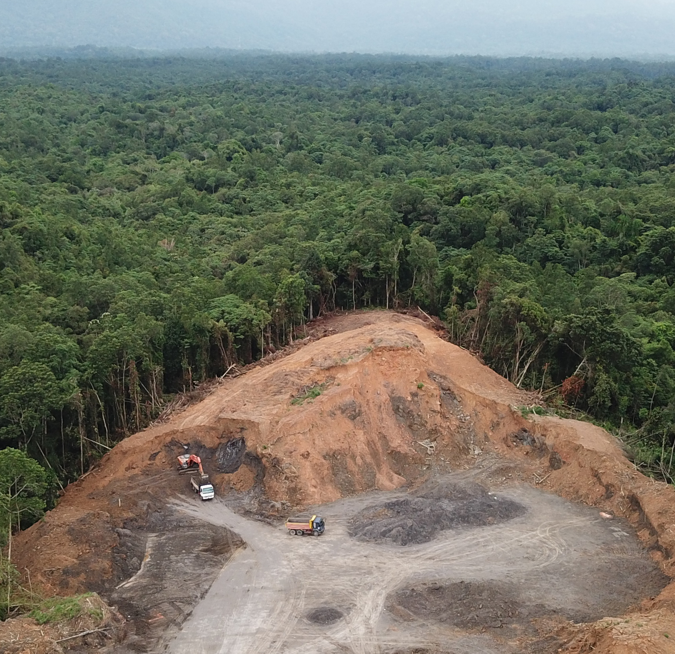
We look to the west and think of those whose land is being destroyed.
Let us pray together:
Loving God, we pray for everyone whose land and security is threatened. Give shelter to families losing their homes. Amen.

Slide 16
We look to the north and think of those in positions of power.
Let us pray together:
Son of God, who chose to serve, we pray that world leaders may serve the common good.
Help them to make wise decisions for our planet and its people, especially the poorest. Amen.

Slide 17
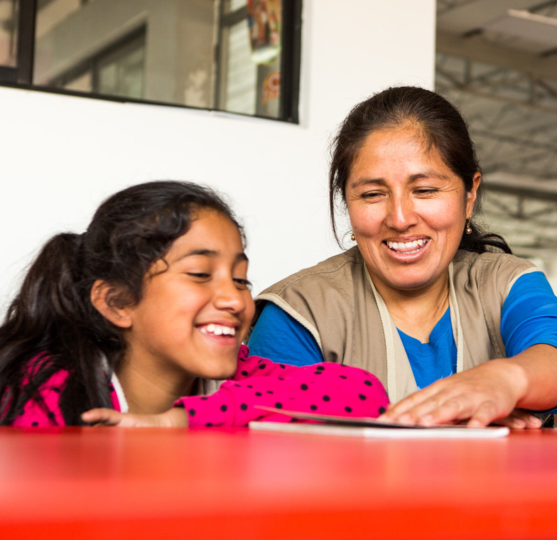
We commit ourselves to work together
to protect the Earth,
our common home.
May we care for one another,
and for all of creation.
Amen.
Notes:
In the name of the Father, and of the Son, and of the Holy Spirit, Amen.

Slide 18
The eyes of the world
are watching.
And so are we.
Notes:
Thank you.
[Photo credits: Eleanor Church; Charmaine Chitate; Roberto Stuckert Filho; CIDSE; Students of St Augustine’s, Billington.]
[Teachers: Thank you for joining our Eyes of the World campaign. Please visit cafod.org.uk/schools to fill in the form so that we know how many of you are watching! Please share pictures of your artwork. Tag @CAFODSchools on Twitter.]

