Slide 1
Year 11 Mock Exam Results Reveal & The Year Ahead

Slide 2
Thank you & Teamwork
Thank you
Some sobering thoughts;
Only get one chance at Year 11
6 months
28 weeks
Don't count the days, but make the days count
Teamwork & Wanting the best:
Year 6 evening
3 parts to this team
More important than ever!

Slide 3
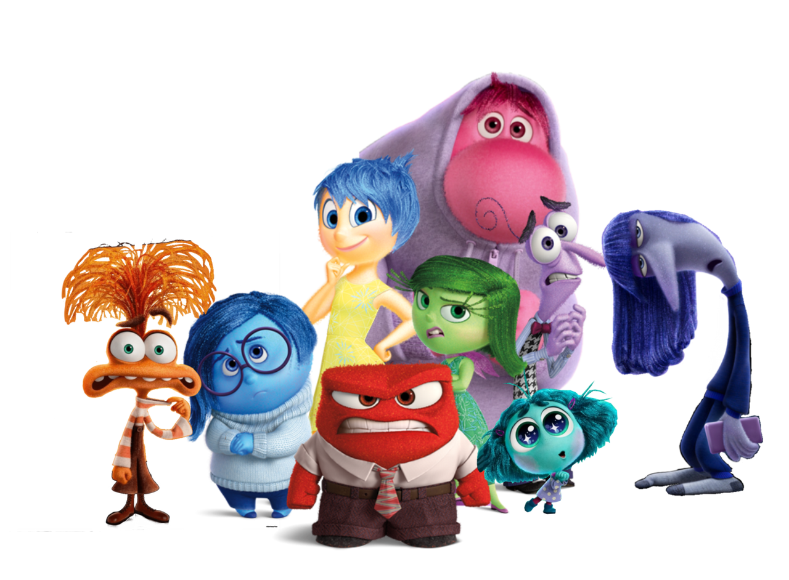
The Results
There'll be a mix of emotions today:
Relief
Joy
Anger
Frustration
Sadness
What these results aren't:
The final results
All you can achieve
A reason to give up – every grade matters!
What these results are:
YOUR mocks
An indicator
A motivator
A starting point

Slide 4
Reflections
When you go home, on Satchel One will be a link to an online reflection form.
There are 21 questions to aid your reflections;
19 for pupils
3 for parents
It'll take approx 10 minutes to complete.
The 3 relating to college courses will aid our planning for WIN sessions
Use this form to gather your thoughts and record your reflections.
Be honest, that's the only way you'll be able to change things that need to change and make improvements that'll mean you are more successful!

Slide 5
How We Will Support Your Child
Study Skills
Sessions
How to revise subject specific guidance
General Study Skills Booklet
WIN Sessions – What I Need sessions
Mentoring for select pupils & creative timetables
February Half Term & Easter Revision Sessions
Regular Homework
Supports with information recall
Supports with exam practise
Pastoral help
Form Tutors, pastoral managers
College awareness & Careers interviews
Open days regularly communicated
Interviews - all will have had an interview by the end of this term

Slide 6
How will they work?
30-minute weekly sessions
Now until Christmas (reviewed after next mocks)
Chocolate to boost energy at the start!
Low-Stakes Retrieval – quiz/mini whiteboards/brain dumps
Exam Technique
Modelling of exam answers using visualisers or chalk & talk
Independent practise for the pupils

Slide 7
WIN Sessions – The Programme
Day | Monday | Tuesday | Wednesday | Thursday | Friday
Lunch | History GCSE PE | English Language Geography | English Language | Geography | GCSE PE Art
After - School | RE Spanish French Combined Science | English Literature Sociology Computer Science/ Creative Media Combined Science | Maths Combined Science Food Tech Music | Maths Triple Science Drama Combined Science

Slide 8
Who will be selected and how will I know if my child has been selected?
Heads of Department have given their suggestions
These plus the completion of your form when you get home will help to shape the make-up of the groups
Miss Moss, Mr Ford, Mrs Nobis and I are meeting early next week to make the final decisions
You will be notified via email and this will be accompanied by an online contract for you to sign to support the sessions

Slide 9
How We Will Support You – sjcs.org.uk/revision
Study Skills
Online clips
Effective Revision Techniques
Myths about revision
How the teenage brain functions and what this might mean for revision!
Things to avoid saying to your child during revision
Getting organised – revision timetables and flashcards
Your suggestions!
Booklets
Subject specific guidance with links to the exam boards, past papers and markschemes
Reach Your Potential – study skills for pupils
Being a call or an email away
Subject Revision Guides purchasable through School Gateway
GCSE Candidate Information | St Joseph's Catholic School (sjcs.org.uk)

Slide 10
How You Can Help
Attendance
Homework
Attendance at parents' evening
Take an interest
Progress trackers in books
Go through the study skills booklet together
be willing to be a revision partner!
Get in touch if you have concerns!
Provide balance

Slide 11
Important Dates
Parents Evening: 21st Nov
1st Progress Reports – End of term 2
January Mock Exam Series – Week Commencing Mon 11th Jan & results report comparing Target, Sept & Jan grades and predicted grades
2nd Progress Reports – end of term 4
Open Events at colleges & deadlines check the website
Contingency Date for exams -
Wednesday 11 June 2025 afternoon
Wednesday 25 June 2025 all day

Slide 12
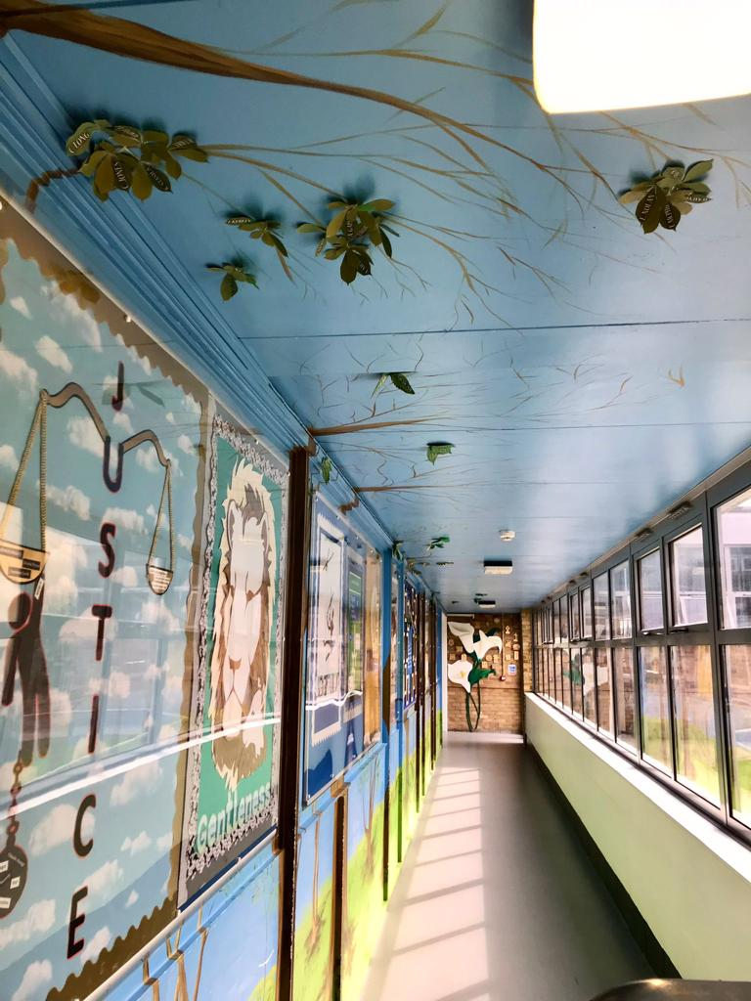
The Year 11 Journey & Events
Lots of good things to come...
Prom
Dance-Off
End of Year Yr11 vs Staff Football & Netball
Big Sleep
Legacy Leaves
Leavers breakfast
House Meals
Year 11 Rewards Trips
Year 11 bonding trip...

Slide 13
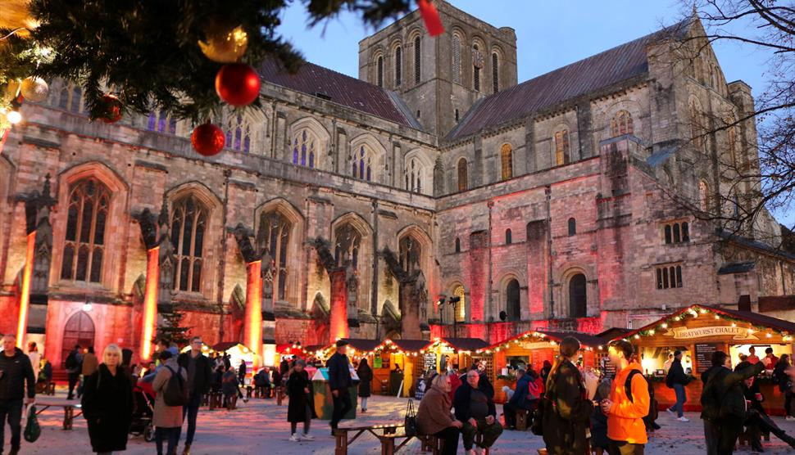
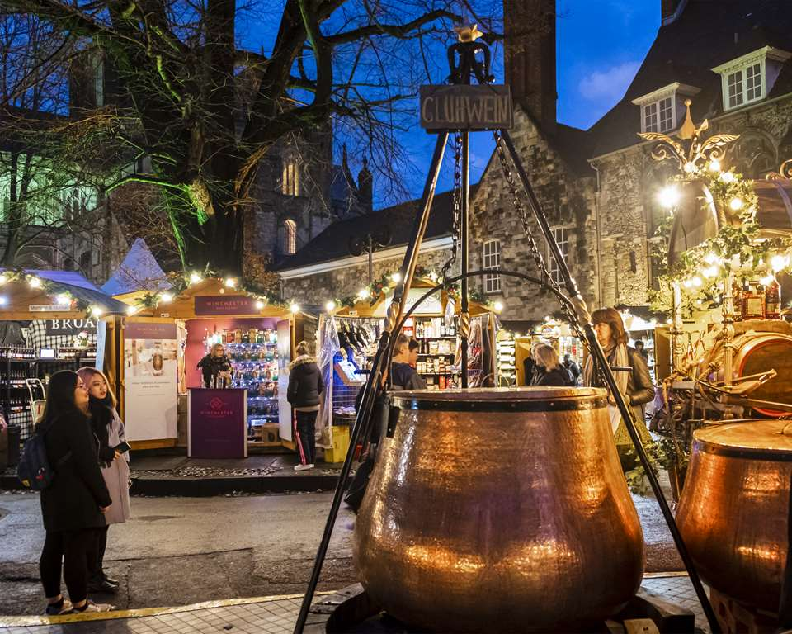
The Year 11 bonding trip...
A Year Group visit to Winchester Christmas Market!
Thursday 19th December
Free time with your friends
Grab some lunch
Do some Christmas shopping
Go ice-skating (details TBC)

Slide 14
Y11 Perks & Feel-Good Friday
What we want to do to support you:
Year 11 common room at lunch time
A revision / work-space for Year 11s at lunch time
Wellbeing activities on a Friday afternoon:
Pre-weekend workout
Wellbeing drop-in
Mindfulness activities

Slide 15
Stay Strong & Stay Together
This isn't going to be easy or plain sailing
We stay strong
We stay together
We play our part
We all 'do our best and mind our manners' no matter how things might feel like they're going!
Don't count the days, make the days count!

