Slide 1
Work Experience Launch 2025
St. Joseph’s Catholic School
Miss Gale
Mrs Nobis
Notes:
Good evening, welcome and thank you for coming this evening.
I am Miss Gale, Careers lead Professional at St Joseph's and work alongside Mrs Nobis (assistant head and SLT Careers Lead) and Mrs Kenny, head Yr10/11.
My role in the school is to lead on all things Careers – I am a Level 6 Qualified Careers Advisor, so provide 1:1 Careers, Information, Advice and Guidance meetings for students, as well as orgnanising & supporting Careers related activities/ workshops throughout the school. Drop in: Monday – Friday lunchtimes to ask any quick questions.
I have a schedule of 1:1's that I book in- can get very busy.
We have some amazing online resources for Careers also- which I will remind you about later in this presentation & on handouts.

Slide 2
Work Experience Launch 2025
What is the World of Work Programme
Importance of Work Experience
Process of Applying
Notes:
This evening we will: Look at the World of work Programme
Find out why work experience is so important
and
What you and your son or daughter needs to do next.

Slide 3
Careers Overview
Notes:
Just to give you a quick context to Careers in St Josephs and where the Work Experience fits into the overall scheme for Careers – it's useful to know that we follow "The Gatsby Benchmarks" which are a framework of 8 guidelines to ensure schools deliver the best Careers provision in education.
The benchmarks are enshrined in statutory guidance and a result of a lot of research. As a school St Joseph's are progressing really well in all areas.
BM5 is Encounters with Employers and employees – which is where Work Experience sits & BM4 Curriculum learning to Careers.
Key Facts – Why Careers is so important; studies have shown the impact a Good Careers Programme can lead to . . . * an increase of up to 20% in wages can be attributed to careers interventions in schools.[footnote 18]
Children and young people who take part in employer engagement, including work experience at school, are more likely to have a positive progression onto Post-16. (Less likely to be NEET)

Slide 4
The World of Work Programme 2025
Notes:
This is where, we, at St. Joseph’s have an amazing "World of Work Programme" for Year 10's, to inform and support student's engagement with employers and employee's; giving them the knowledge and tools to do this effectively.
It's a programme that has been running successfully for several years, and one that we are very proud of.
The "World of Work Programme" is done largely via PSHE and within English lessons, to be ready and prepared for Work Experience and beyond.
We do this by:
Helping our pupils to develop themselves through careers, employability and enterprise education
Learning about careers and the world of work
Developing career management, employability and enterprise skills – so they have the skills in the future to manage their own career pathway & decision making
During our World of work programme we want we want our pupils to really experience the process of what it is like to look for and apply for a job! To be able to recognise their skills and qualities, use research skills so that we can equip young people today for the career choices of the future.

Slide 5
World Of Work Programme 2025
Job Application
Identify a job
Create a CV
Write a tailored cover letter
Interview preparation
Mock Interview
Work Experience (WEX)
Approaching employers
Setting up work experience
Attend 1 week WEX
Notes:
The world of work Programme consists of 2 main tasks – 1) Job application – from selecting a job via our own SJCS job agency (on our website, careers portal), to having a mock interview with an employer.
2) Work Experience – researching an employer, making contact, setting up and doing paperwork and attending for the week.
All of this as a programme should put your child in the best possible position for future applications – including Post-16 applications.

Slide 6
Task 1: WoW – Job Applications CHOOSE YOUR JOB!
Notes:
First job pupils will be tasked with is to choose a job profile through our very own company – Going Places!
This will be in preparation for the CV Writing Workshops.
There should be a good variety, but equally there may not be the exact job you are looking for!
Life can be a bit like that when we are looking for employment.
However, you will need to choose one of them and your CV, Covering Letter and Interview will be based around this job description.

Slide 7
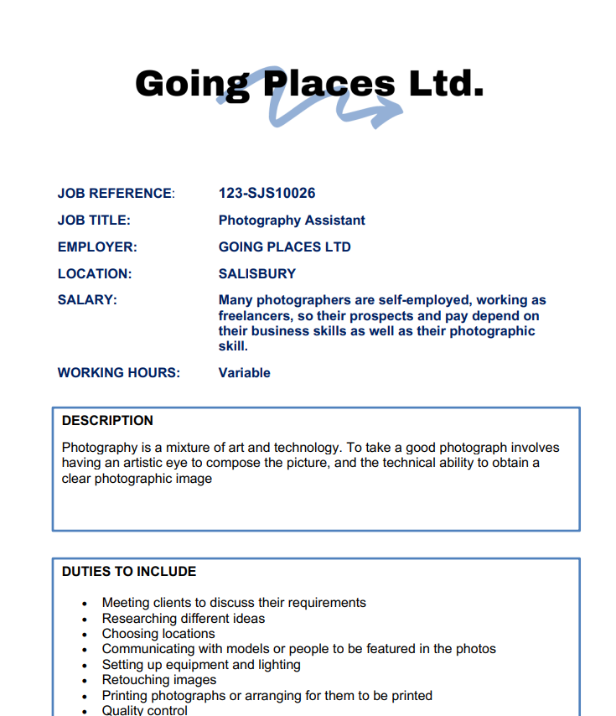
Notes:
Did you know we have our own SJCS Employment Agency: Going Places?
Students will select look at the wide selection of vacancies on the employment agency website: we have jobs roles in Agriculture, Art, Business, Construction, Childcare, computing and many more . . .
Whole programme is about the process and skills needed to apply, so don't worry if there isn't an exact match for what they would like to do – pick the best fit. (feel free to look through this on website with child, get an idea of what they are interested in).

Slide 8
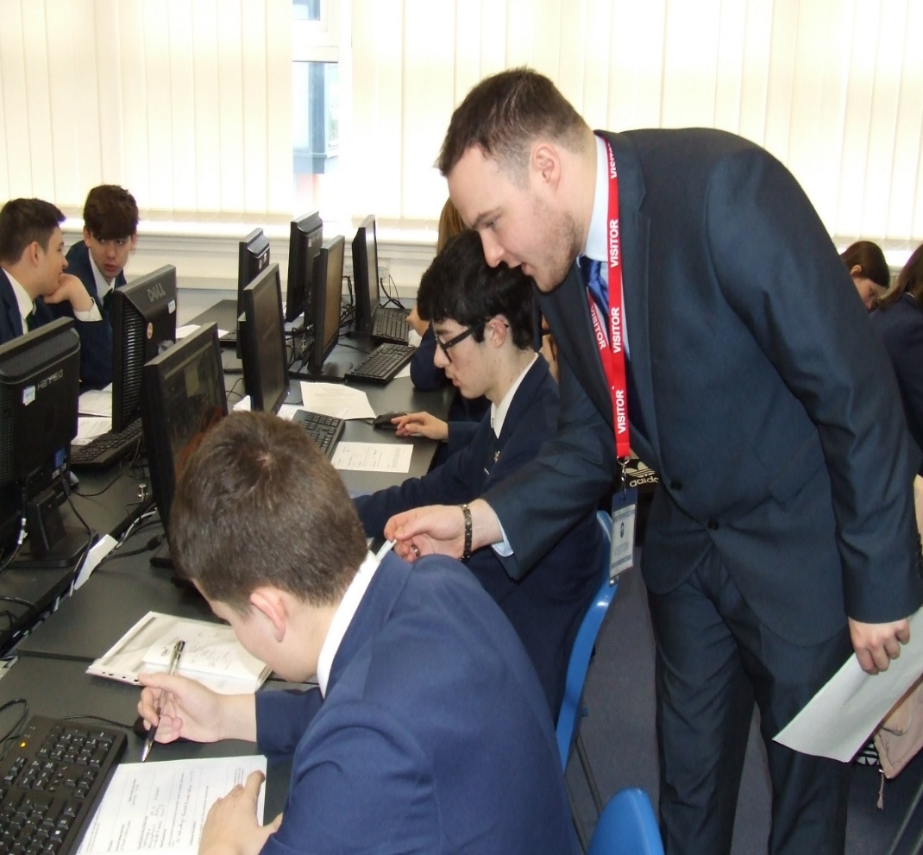
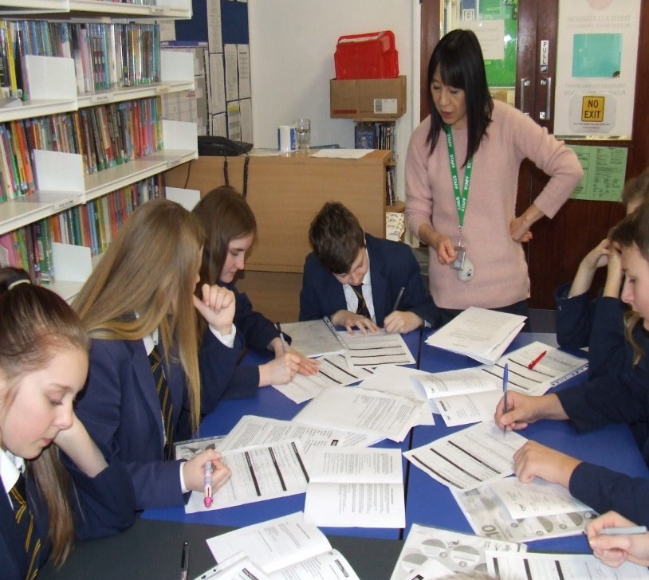
Interview Preparation sessions Feb - March 2025
Notes:
CV & Covering letter
Then in Feb - March students will be guided in specific session to prepare their CV’s and covering letters – with our support.
These need to be completed during their allocated sessions (possibly some homework time to research jobs). Whatever state they are handed in to us this will be used for their interview with a local employer – so really important to make the most out of session, time to complete at home and hand in - MUST be done . . . Re-emphasising how much first impressions count and that the interviewer will be forming an opinion by the way the CV is presented.
Pupils will also complete a Covering letter through their English lessons, tailored to their chosen job from our very own Employment company.
These Covering letters and CV's will be shared with employers in preparation for their mock interviews.
Here are examples of teachers supporting pupils.
Please note this is NOT their WEX – this is in prep for their mock interviews- I will go over Work Experience separately.

Slide 9
Interview Prep Talk – via PSHE March 2025
Effective Communication
First Impressions
Interview Techniques
Virtual Times
Notes:
(Canx?) In March we will be working with students in PSHE to help them learn about doing a great interview! (Hopefully have an outside speaker!)
Effective communication both non-verbally/verbally/written
How first impressions really count – What you wear – how to introduce yourself – how to use your voice to sound assertive
Interview Techniques – Understanding good and bad techniques and practising the good ones.
They will also introduce our pupils to the concept of how virtual interviews and how they are very much becoming the norm.
This will equip you with all the skills you need to really shine at interviews!

Slide 10
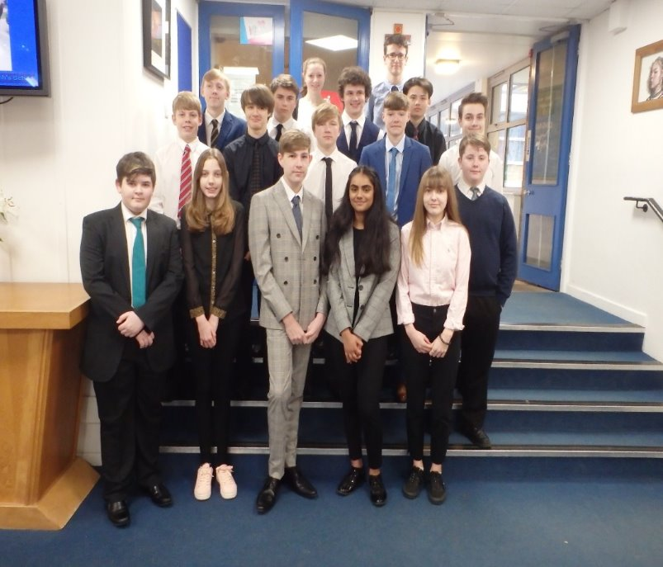
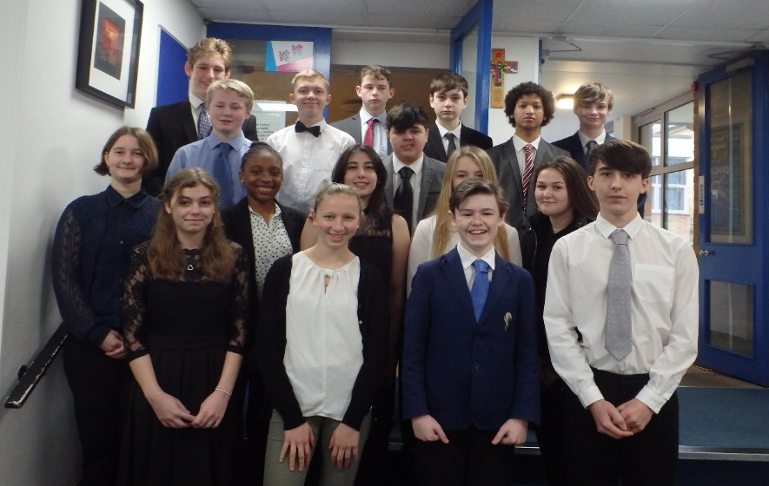
Mock Interview Day – April 2025
Notes:
In March/April, 2025 all pupils will have an interview with a local employer.
The interviewer will be given your completed CV and Covering Letter prior to your interview in whatever state it's handed in to us!
In previous years pupils have really enjoyed this day….yes it can be really nerve-racking and they can feel nervous, but they gain so much from the experience that the feedback we receive from pupils after the event has been very positive. It’s such good preparation for job and college interviews in the future. The interviewers are not there to catch you out. They will be marking your interview, how you come across, your ability in responding to questions and your general manner and this will be fed back to them, in written form, after the event.
Here are some photographs of previous mock interview days. Pupils can either attend in smart work clothes or in school uniform. There is no requirement to go out and buy an outfit!
2 slides

Slide 11
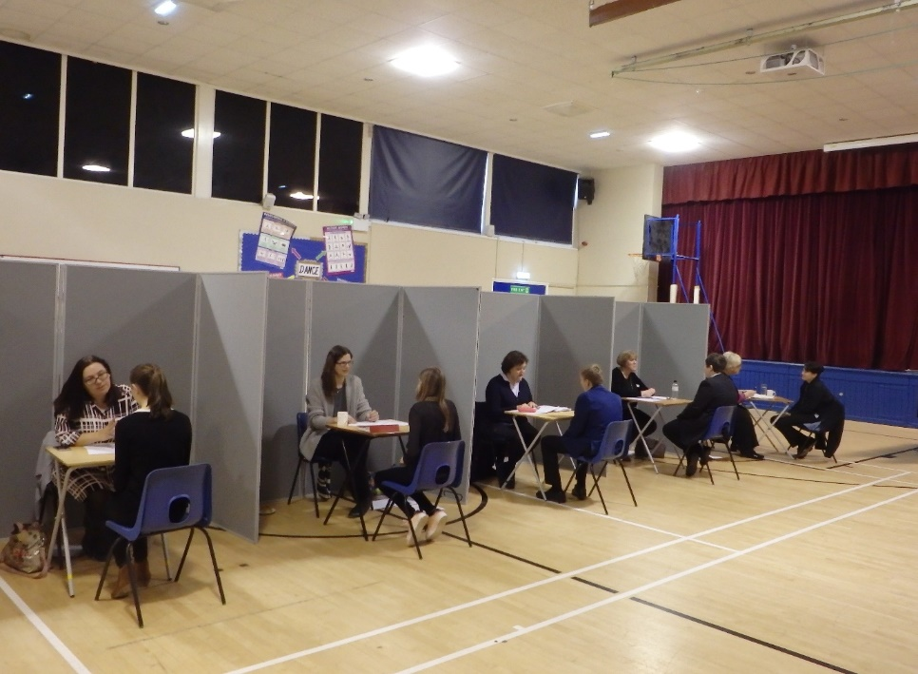
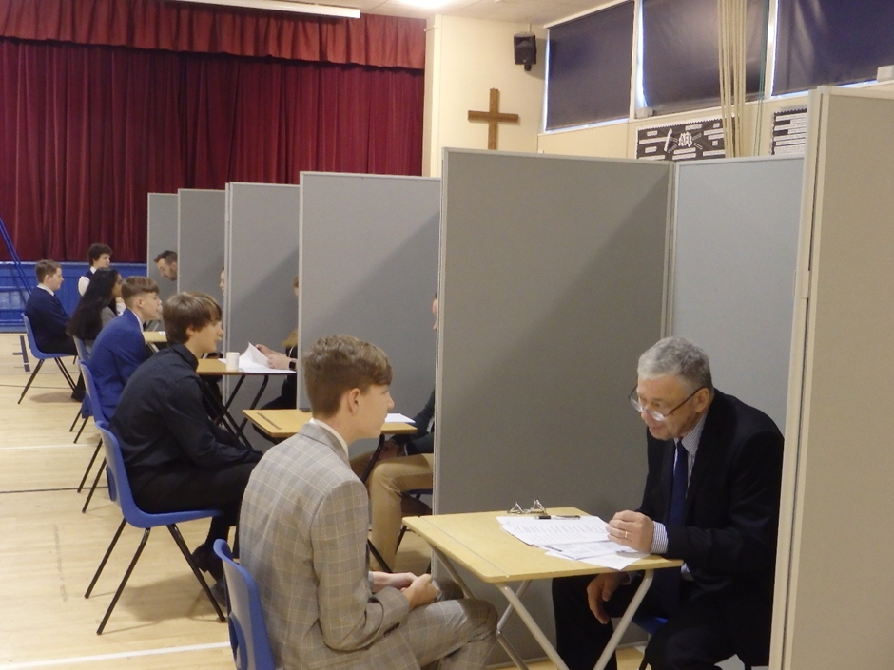
Mock Interview Day – April 2025
Notes:
Students will be given initial feedback on the "mock interview day" regarding their CV, covering letter and interview skills.
Aim is all very positive and give them positive feed back – What they did well, as well as what they can do to be even better.
All will be marked and given feedback on their CV, cover letters

Slide 12
Task 2: Work Experience WEX is LAUNCHED! 28th January
Notes:
Our launch happens now and for all students in school, through PSHE, starting fully now! Don't let them think I've got ages before the deadline – as places are difficult to get and competitive! If they wait – They WILL miss out! We don't want that!!
Pupils will learn more about the new LINK2+ WEX database we will be using and the process, as well as how to approach an employer for WEX, via their PSHE and tutors; parents will be updated accordingly via school comms.

Slide 13
What previous students have said . . .
Notes:
Our launch happens now and for all students in school, through PSHE, starting fully now! Don't let them think I've got ages before the deadline – as places are difficult to get and competetive! If they wait – They WILL miss out! We don't want that!!
Pupils will run through the process and what is involved in the "World of Work programme" and how to apply for a placement as well as learn more about the new CWS Grofar database we will be using.

Slide 14
Work Experience Week Monday 23rd to Friday 27th June 2025
Notes:
Work experience will then be delivered between 23rd and 27th June 2025, where we really encourage every pupil to go out and find a placement.
It doesn’t necessarily need to be within the sector they wish to work in, as sometimes there can be restrictions around confidentiality, safeguarding and age. Work experience is exactly what it says on the tin! It is about the experience of being in the workplace and understanding the importance of skills they can take, learn and develop new ones!
We certainly notice how some pupils absolutely flourish and mature in their new environment.

Slide 15
Why do work experience? https://youtu.be/vPcQazsFca8?feature=shared
Work experience:
gives insight into the skills needed for a particular job
is an opportunity to test out a job to see if your child really likes it
can broaden their knowledge of jobs they have never considered
will increase their awareness of their of their own skills and strengths
helps them understand how the subjects they study in school link to certain jobs
gives insight into what the world of work is really like and employers’ expectations
can increase their motivation in school
puts them in contact with potential employers
can give them useful experience for the CV and provide references
helps them appreciate the skills needed to succeed in a job
Notes:
Why do work experience?
Work experience:
gives insight into the skills needed for a particular job
is an opportunity to test out a job to see if your child really likes it
can broaden their knowledge of jobs they have never considered
will increase their awareness of their own skills and strengths
helps them understand how the subjects they study in school link to certain jobs
gives insight into what the world of work is really like and employers’ expectations
can increase their motivation in school
puts them in contact with potential employers
can give them useful experience for the CV and provide references
helps them appreciate the skills needed to succeed in a job

Slide 16
"He has greatly impressed the staff with his strong communication skills and confidence."
-Tesco Superstore Amesbury
"An absolute credit to the school. Hardworking and pro-active. We'd love to have more of your students next year."
-Crafty Cup café in Wilton
“St Joseph's are "the benchmark of how other schools should do Work Experience" and "your students are the best we've had".
"He is genuinely enthusiastic and is really enjoying being helpful, especially little tasks in preparation for next year. He is taking pride in what he is doing. He has worked well with small groups of children in class and with direction is becoming more confident in this"
"Just to say it was lovely having both of the boys in school this week, they were very polite and engaged well with the children. They were very willing to do any job on Monday too!"
-Sarum St Paul's Primary School
"He attended his first day with enthusiasm and interest. He undertook ever task set and achieved his goal each time. He has fitted in really well with the team." Hayball Motorcycles Ltd
Notes:
Feedback from local employers about pupils who have been on placement.
For one young person there was even an offer of employment for the future! (Hayball Motorcycles Ltd) cont. Volunteering, reference etc.
Radio station, architects network for future, college applications etc.
Having spoken to some Year 11's this week – they were all really positive about their Work Experience and in 1:1's WEX has really helped them to make decisions for the future and get to know themselves- their skills, qualities and areas they wish to develop.

Slide 17
Costs
Basic Placement - £28
Payment for the placement must be made on-line or by cheque when returning your child’s form
Late submission of forms – cannot be processed.
Notes:
I shall now cover the Work Experience Placement and how it is run at St Josephs.
There is a charge for WEX placements, which this year is £28.
This amount covers the costs for SWEP (Somerset/Southwest Work Experience Partnership) to do vital health and safety and employment checks, to ensure we have all the relevant information for the placement and that it is appropriately "risk assessed" as well as access to WEX support. This ensures that your children are safe at their placement.
However, we do not want there to be any financial barriers preventing any of our pupils taking up a placement. If you would like to discuss this further then please speak to me, Miss Gale, in the first instance as there maybe financial support available. My details will be shown at the end of this presentation.
Payment for WEX must be made when your son or daughter hands in the pink form which tells that school who the placement is with.
This year, we are using a new provider for these checks and luckily, while most things are going up – we have managed to reduce this cost and there are no additional out of area costings, as we have had previously.

Slide 18
Find an employer
Make contact – ask if they can do WEX
Confirm
Pink Forms (MUST have employer & public liability)
Notes:
How to apply?
Find an employer
Make contact
Pink Forms - The pink form (pink purely for an admin ease! These can be photocopied in any colour you wish!). This will need to be completed by you the parent/carer the pupil and the employer where your son or daughter is doing their placement.

Slide 19
Finding an Employer
Contact companies where you would like to do your work experience
Database – Miss Gale – Friends, relatives……network!
Be proactive!
Think outside the box
Notes:
The first thing you need to do is think carefully about where you would like to do your work experience. Some of you have some ideas and that’s great. If you are stuck and need some help please arrange to see me through Mrs. Fenwick. I will also signpost you to some useful websites that will help generate ideas.
We encourage you to contact businesses directly. Do some research! Find out who does digital marketing, cyber security, carpentry, engineering locally, or even a bit further afield. In your booklets are clear guidelines about how to access CSW’s database to search for placements within our catchment area. This can be used alongside proactively looking for your own placement. Most people get jobs by networking so use this as a way to find work experience too.
This is for Mum’s, Dad’s and Carer’s – by all means help and encourage but please do not do the work for them. Finding a job IS HARD and they will not learn if you do it all for them….believe me…..I’ve been there! Then they come back and say “I never wanted to do that anyway….it was boring….”. Encourage your son or daughter to be proactive.
Not all plumbers work independently……the NHS employ plumbers, Wiltshire Council employ electrical technicians…….think a bit wider…….

Slide 20
Finding an Employer 2
Career Aspiration
Related role
Subject they enjoy
Skills development
Personal development
Notes:
Could be related to:
Jo/ Career aspiration – what they want to do in future – not always possible age/ GDPR etc.
Related role – ie. Law, can do estate agent- letting; recruitment/ HR – legal elements and process'
Linked to a subject they enjoy – English – work for a marketing company; or within HR/ contracts; PR; radio/ journalism . . .
Skills development – need to gain more problem-solving skills, teamwork, communication . . .
Personal development – confidence, self-esteem, reduced anxiety

Slide 21
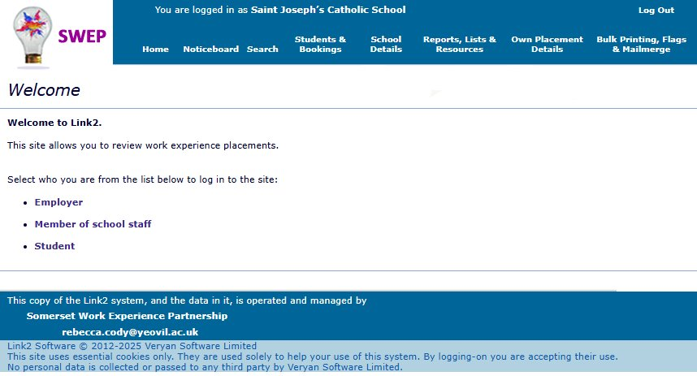
Using the Link2 Database https://ssp.learnaboutwork.net/
Notes:
As a brief overview: SWEP are our WEX providers who do the Health & Safety Checks.
They have a database, called Link2+ - where pupils can access employers who have supported WEX placements in the past. Not definative, but a good starting point and where all placements will be finally logged/ input.
This information can be accessed by logging onto the Link2+ system – PIN codes will be given to them via tutors.
If they don't have this – they need to come and see me or speak to tutors so we can sort this.

Slide 22
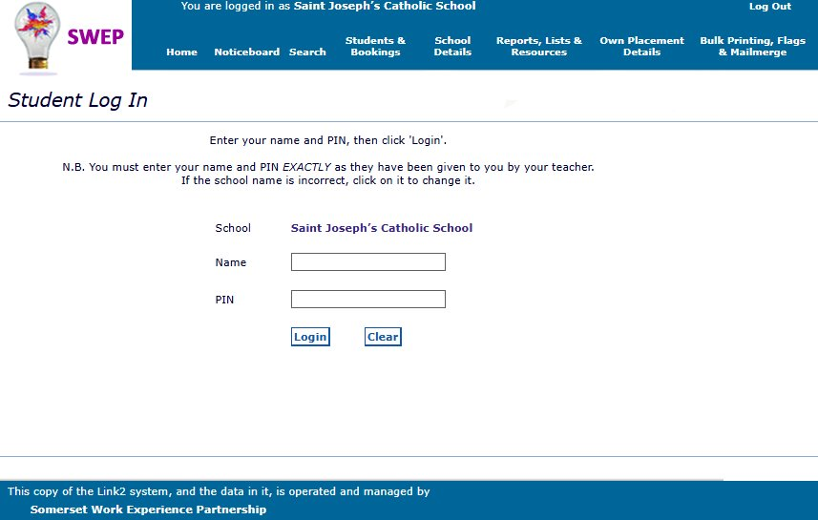
Using the Link2 Database https://ssp.learnaboutwork.net/
Notes:
As a brief overview: SWEP are our WEX providers who do the Health & Safety Checks.
They have a database, called Link2+ - where pupils can access employers who have supported WEX placements in the past. Not definative, but a good starting point and where all placements will be finally logged/ input.
This information can be accessed by logging onto the Link2+ system – all students will be given a PIN, via tutors.
Any issues – they need to come and see me/ tutor to sort.

Slide 23
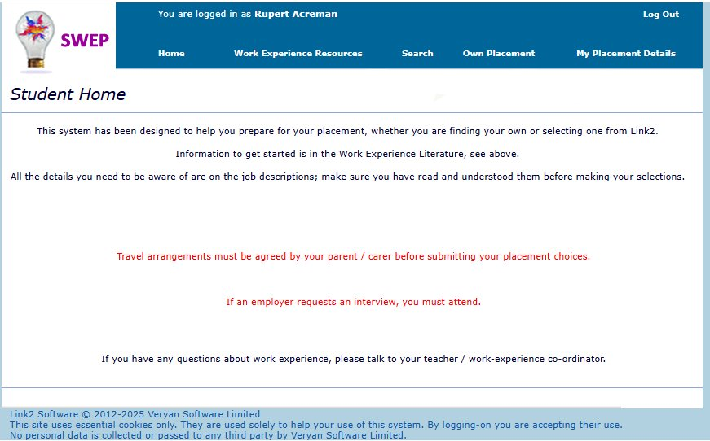
Notes:
Reminder of travel . . . Your responsibility- choose sensibly.

Slide 24
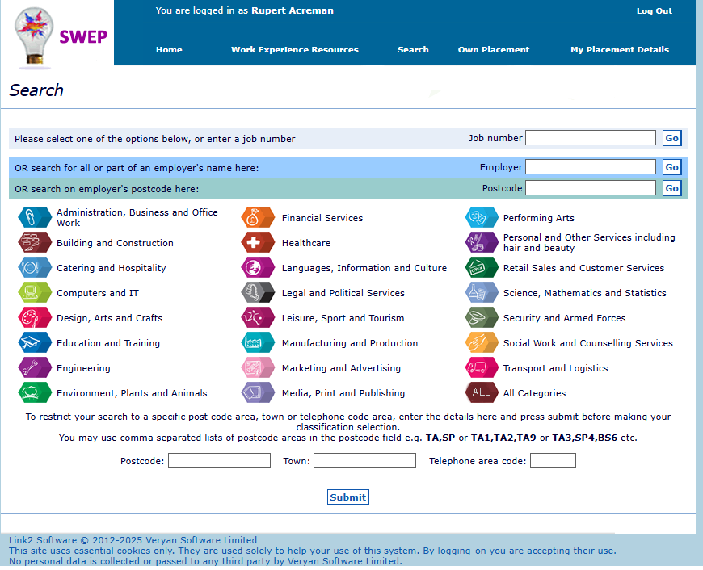
Go to "Search"
You can search by:
"Employer" if you have somewhere in mind, or you can do a general search for estate agents or school, by using the % symbol ie.
‘%Estate Agent’ or "%school"
"Postcode" or "Town"
After you add a postcode, or town press "Submit" If you clear searches, make sure you press "submit" to refresh the page; then select a category.
Notes:
Link2, Database site: https://ssp.learnaboutwork.net/

Slide 25
Found an employer – what next?
Complete blue 3-way agreement form and cream Health form and return to Miss Gale/ Tutors with online payment.
Health and Safety Check – Conducted by SWEP
Once accepted – student can log in and see full details They will get a printed copy several weeks before they begin.
Notes:
If you have found an employer what next?
Blue 3 way agreement form and cream Health form needs to be completed by the pupil, parent/carer and the employer and returned to the school with online payment.
Health and Safety Check – Conducted by SWEP
Once accepted – student can log in and see full details They will get a printed copy several weeks before they begin.

Slide 26
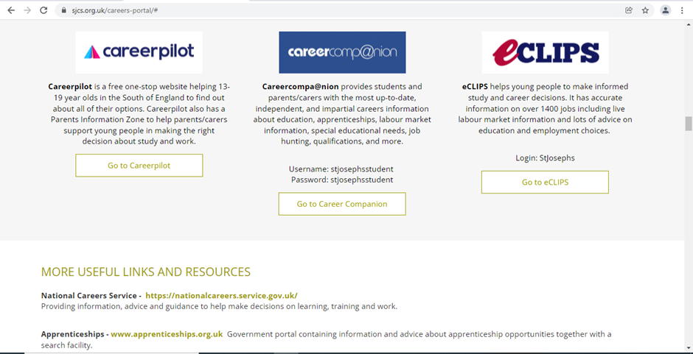
Notes:
Other resources available – I mentioned our Careers website portal on the main St Josephs website. This can be accessed through the curriculum link.
I would suggest they look at Careerpilot and the quizzes section. There are many different quizzes that will generate ideas for them by the way they respond to certain questions or visual pictures (SACU and the Spartan Test).
They could also explore careers that could develop from subject interests or job sectors. These are all available on Careerpilot.

Slide 27
Notes:
Labour Market Information, or LMI for short, is vital for our pupils to understand the jobs market both locally and nationally.
Film? to explain this further. Our pupils access this information through their careers education lessons and through using the software package - Careerpilot. Can also use Work Wiltshire for a more local level.
2min 15.

Slide 28
Where are future jobs going to be?
Medical, Health Science and Care
IT and Digital Technology
Engineering and Construction
Environmental (Green Jobs)
This is Labour Market Information (LMI)
Be in the know to know where to go
Notes:
Labour Market Information (LMI) means knowing where the job will be – these sectors are predicted to grow a lot and through new technology and science developments there will be lots of brand-new jobs for people to do
What are the top jobs of the future?
In 2022 the Office for National Statistics predicted that, by 2030, there will be a need for:
an additional two million jobs in health and social care
600,000 new jobs in professional and scientific services
There will also be a demand for 800,000 new jobs in education
as well as an extra one million jobs in construction.
Green Jobs -There are already an increasing number of Green jobs which are roles that contribute to preserving or restoring the environment and our planet.
The Space Sector - Space is one of the fastest growing sectors of the UK economy, supporting jobs for some 117,000 people. Careers in space cover everything from building spacecraft and designing satellites, to coordinating disaster relief and forecasting future climate. The space industry employs engineers and scientists, accountants, lawyers and communicators.

Slide 29
Trouble finding a placement?
Have you tried everything?
Speak to Miss Gale!
Your tutor
Subject teachers
Notes:
Drop in's lunchtimes . . .
Do your work first!!!

Slide 30
The Placement
Summer term – pupils contact their placement
Pupils keep a work experience diary to record skills they have learnt
Staff visit or telephone placements
Notes:
Important for pupils re-establish contact with their placement as staff leave or forget!
Confirm 1st day times, who to report to, what to wear etc. Build the excitement!
Paperwork deadlines in March/April - so students will need to re-contact in the summer term before placement to confirm all details.

Slide 31
Reflection and Evaluation
The skills they have learnt?
What did they do/what was the role?
The highlights/downside to the role?
The effect on future plans?
What were they good at/not so good at?
How have they benefited from WEX?
Are they likely to pursue it as a career?

Slide 32
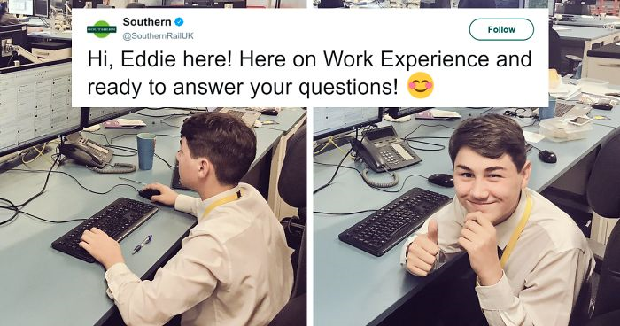
…..you never know what might happen!...
Notes:
A 15-year-old work experience student from south London was left in charge of Southern Rail's Twitter account.
And for a feed usually dominated by the complaints of angry commuters, things soon turned pretty surreal.
The teenager introduced himself on the social network at just after 2.30pm and within moments Southern Rail's 161,000 followers were tweeting Eddie questions. Probably a welcome change for the beleaguered rail firm, which has faced months of criticism from customers for cancelled services and strike action. A bitter dispute over the role of guards has affected Southern passengers for more than a year.
I suspect he will go far…..and have an amazing CV to impress future employers with!

Slide 33
What if I don’t find a placement?
This year you will remain in school and catch up on lessons as normal!
Notes:
This year you will remain in school and catch up on Lessons as normal!

Slide 34
Virtual Work Experience
Other work experience that our pupils can access is SpringPod and Speakers for Schools who all offer virtual Work Experience so check these out. Details are sent via School Comms, Form Tutors and via Teams. They are also promoted on the Careers Portal on our School website. These must however be completed in your own time!
All of these opportunities can enhance applications to college, 6th form, for Saturday Jobs and applications to University in the future.
Notes:
Other work experience that our pupils can access is SpringPod and Speakers for Schools who all offer virtual Work Experience so check these out. Details are sent via School Comms, Form Tutors and via Teams. They are also promoted on the Careers Portal on our School website. If anyone is unsure speak to the Careers Team and also available on our Careers Portal. These must however, be completed in your own time!
All of these opportunities can enhance applications to college, 6th form, for Saturday Jobs and applications to University in the future.

Slide 35
Timeline for the World of work programme
From end January 2025 WEX Launch through PSHE
Feb/March 2025 Mock Interview Preparation support
March/April 2025 Mock Interview Day
31 March 2025 WEX Initial Application - deadline
22 April 2025 WEX FINAL Application deadline
23rd – 27th June 2025 WEX Week
Notes:
Overview and timeline for the WoW Programme: 2 separate sections form the WoW - Application and applying for a sample job that they will be interviewed for AND the Work Experience programme. Whole process, 2 parts enables them to experience, as close as possible, what it's like to search, apply, interview and then go out to work – setting them up with skills for life.
From end January 2025 WEX Launch through PSHE
Feb/March 2025 Interview Preparation support
March/April 2024 Mock Interview Day
31 March 24 WEX Initial Application - deadline
22 April 24 WEX FINAL Application deadline
23rd – 27th June 2025 WEX Week

Slide 36
Year 10 Work Experience
Monday 23rd June –
Friday 27th June 2025

Slide 37
Notes:
I hope you have found this useful.
On our Careers Portal there is the opportunity to feedback about this presentation or any other matters relating to careers.

Slide 38
Parent/Carer Feedback Form!

Slide 39
Contact details for Miss Gale
Email: vgl@sjcs.org.uk
Tel: 01722 335380
Notes:
Don't forget feedback form for WEX- give us an idea so we an keep eyes and ears open for students; also remember Appren-T-Fest tomorrow!!
Mrs Kenny WEX initial feedback form: https://forms.office.com/e/0r5ymqDArA

